Slide 1
The Use and Performance of Hashing Algorithms
HICSS Session 2

Slide 2
Additional material on hashing:
A set of four exercises were developed to illustrate hashing concepts . The four exercise takes about an additional hour or two of class time depending upon the level of detail need to discuss the concepts. They can be introduced before or after the BARTS simulation and present additional insight into the hashing concepts.
These exercises were first introduced at the 2018 North Eastern conference for the CSCC in Arlington Virginia. The paper received the best student paper award ("A-Nonce the Use and Performance of Hashing Algorithms), but the paper and content has not published in any proceedings or journal.

Slide 3
Hashing Overview
What we will cover:
  What is a hash?
  Where are they used?
  Applications of Hashing
  Exercises
A solid foundation of how hashing works is required to understand many computer science concepts.

Slide 4
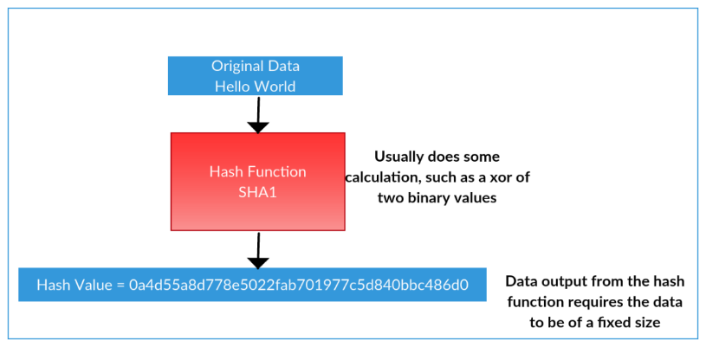
Hash Example
A hexadecimal representation of data.
Notes:
Here is where we want to discuss how the hash functions works: the text “Hello World“ is converted into a hash value after it passes through the hash function SHA1.

Slide 5
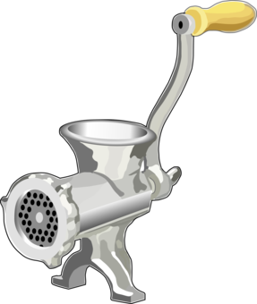
The hash is like a fingerprint of the data: Data goes in and hash comes out
Hello World
b08022d315cf1eb12d2665bded0e6af40653c0a0be975232fb49bcbd021cfc36
SHA 256
Hash algorithm
The data fingerprint

Slide 6
Notice the hash value is different after processing two data stings through the SHA 256
Jody 3 BARTS to Sean
6341a2308b516ba386a8290d14d82fd82eb25b4ed0ecbb7eecc8ff9ff9f80f0c
Jodi 3 BARTS to Sean
c2608a6a1f62e75cb87e4f9bdff4bfc6afb54f886c2c9848a4a1ca044250ed39

Slide 7
SHA 256
Details on the SHA256 Hash Algorithm Process

Slide 8
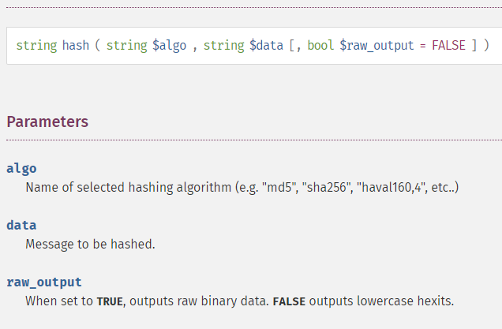
Hashing calls in php
The hash result is always the same length depending on the hashing algorithm that is used.
575d72eae0dcf91376577c54eabaa1eea7c8a61b1874e8ad305c3c84f9148b16
It doesn’t matter how large your text is.

Slide 9
Example of how hashing algorithm is executed

Slide 10
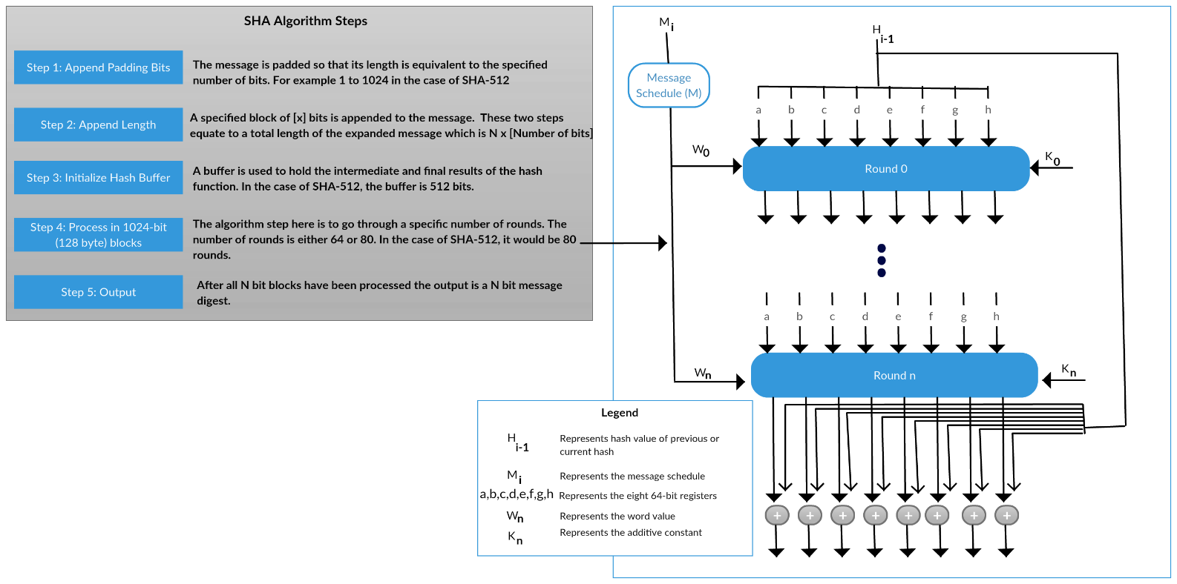
Technical Details of Hashing Algorithm
Notes:
Here is the computational steps required for computing a SHA hash. We first have the message in binary, represented as M_{i}. A specified block of x bits is appended to the message. The two steps equate to a total length of the expanded message, which is N times the number of bits. A buffer is used to hold the intermediate and final results of the hash function. Then we go through a number of rounds that depend on the algorithm used. Each round utilizes an exclusive or by the additive constant represented as K_{n} and the hash value that was calculated at the specific round. Finally, we xor the output of the last round by utilizing an exclusive or of the final output of Round n by the hash value of the previous hash.

Slide 11
Hashing Applications
Secure hash algorithms are used to verify that data has not been altered, such as in:
  Man-in-the-middle threats and attacks where an attacker sits between two parties and monitors or alters communication.
  Password protection
  Digital signatures involving a process that ensures that message contents have not been changed during transport.
  Blockchain ledgers and cryptocurrency mining.

Slide 12



Preventing Man-in-the-Middle Attack with Hashes
Original text prepared by secret agent is hashed
Man-in-the Middle attacker alters text
Receiving secret agent compares the two hashed values
Can we meet at Grand Central Station at 1pm?
Can we meet at Pier 11 at 1am?
Check to see if hashes are the same
SHA 256
Hash algorithm
Hash of text sent by attacker
83ac24b400caeb …
SHA 256
Hash algorithm
Hash of text sent by different route
4ccab6eec0e973 …
Notes:
Here is a quick demonstration of how man-in-the-middle attacks can be prevented through the use of hashing. Hashes are nothing more than a method of fingerprinting. This means you can authenticate that the data sent is original and hasn’t been altered.

Slide 13
Secure Hashing Applications cont.
There are numerous malicious hashing applications, including password crackers

Slide 14
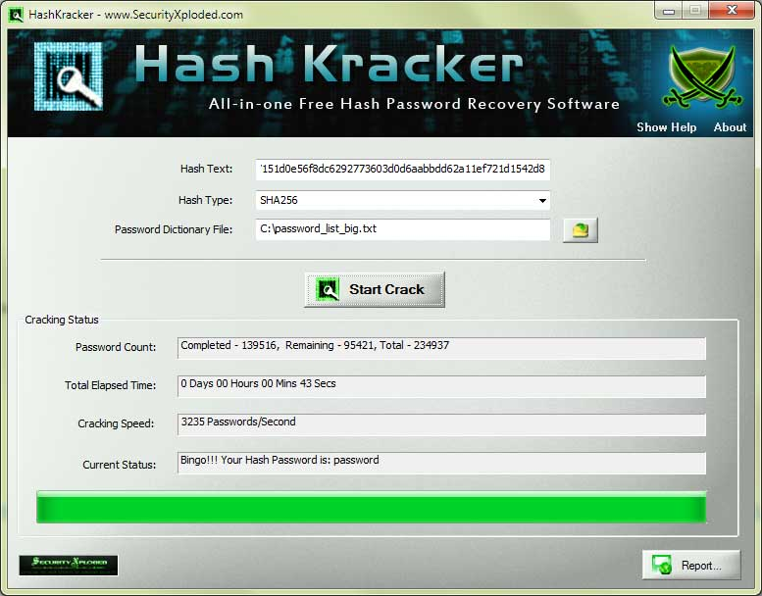
Notes:
Hash Kracker is an example of a malicious hash cracking application that attempts to check if any password hashes match the ones in the password dictionary file. You will notice the time it takes to get a password can be quick, if and only if it exists in the dictionary file.

Slide 15
SHA256 Value of several common passwords that could be put in a password cracker dictionary.
PS: The user ids here are GOT names used for baby names in 2018.
User ID | Password | Hashed Value
Arya | 123456 | 2c43c95d0f764aaea9a7ce3caa48803725a887f48cb3472b7087b0ba8ed98805
Tyrion | password | 5e884898da28047151d0e56f8dc6292773603d0d6aabbdd62a11ef721d1542d8
Brienne | 12345678 | ef797c8118f02dfb649607dd5d3f8c7623048c9c063d532cc95c5ed7a898a64f
Jorah | qwerty | 65e84be33532fb784c48129675f9eff3a682b27168c0ea744b2cf58ee02337c5
Sansa | 12345 | 5994471abb01112afcc18159f6cc74b4f511b99806da59b3caf5a9c173cacfc5
Catelyn | 123456789 | b0837559f9c780da799214524dc2dde7228c29c89e61f33e37aa1e8d14a82819
Ellaria | letmein | 1c8bfe8f801d79745c4631d09fff36c82aa37fc4cce4fc946683d7b336b63032
Oberyn | 1234567 | 8bb0cf6eb9b17d0f7d22b456f121257dc1254e1f01665370476383ea776df414
Theon | football | 6382deaf1f5dc6e792b76db4a4a7bf2ba468884e000b25e7928e621e27fb23cb
Gregor | iloveyou | e4ad93ca07acb8d908a3aa41e920ea4f4ef4f26e7f86cf8291c5db289780a5ae
Sandor | admin | 8c6976e5b5410415bde908bd4dee15dfb167a9c873fc4bb8a81f6f2ab448a918
Khal | welcome | 280d44ab1e9f79b5cce2dd4f58f5fe91f0fbacdac9f7447dffc318ceb79f2d02
Daenarys | monkey | 000c285457fc971f862a79b786476c78812c8897063c6fa9c045f579a3b2d63f
Notes:
Here are several common passwords that could be put in a password cracker dictionary.

Slide 16
Bitcoin miners are all about hashing
Use specialized computers to solve a computationally intensive hashing problem

Slide 17
Nonce
Definition (American Heritage Dictionary): A word coined and used for a single or particular occasion.
  * I thought I invented a unique nonce to describe people full of beer: “He was gambrious from drinking that stout ale.”
  * But gambrious is actually a word.
Definition (cryptography): An arbitrary number used just once.

Slide 18
Mining Complexity
Mining complexity, or time to mine, is managed by controlling what hash is acceptable.
It takes more time to generate a hash with 8 zeroes in front than 4 zeroes.
  Hash with one zero requires about 16^¹ or 16 attempts.
  Hash with two zeros requires about 16^² or 256 attempts.
  Hash with three zeros requires about 16^³ or 4096 attempts.
Right now Bitcoin miners have to generate hashes with 17 leading zeros. This requires billions of calculations.
Watch these two videos for more information:
  Solomon Lederer video
  Gary Sims video.

Slide 19
Four Hashing Exercises

Slide 20
Exercise 1: Generate a nonce that will result in a leading zero for a hash.
Steps:
Go to URL: https://tinyurl.com/ZeroHashMining
Enter your first and last name into the submit box. Click Submit.
Change the first letter in your last name from upper to lower case. Click Submit.
Enter your first, and then last name followed by the number 1 into the text box. Click Submit. If the first character is a zero stop. Capture the screen and save it. If the first character was not a zero, keep incrementing the number following your name by one more unit until you generate a hash with one leading zero. Capture the screen and save it.
Cut and paste some data into the text box. Click Submit.
Change any letter in the text and Submit.
Extra credit: keep adding numbers until you get two leading zeros. (Don’t try anything beyond two leading zeros, for it will take a long time.)

Slide 21
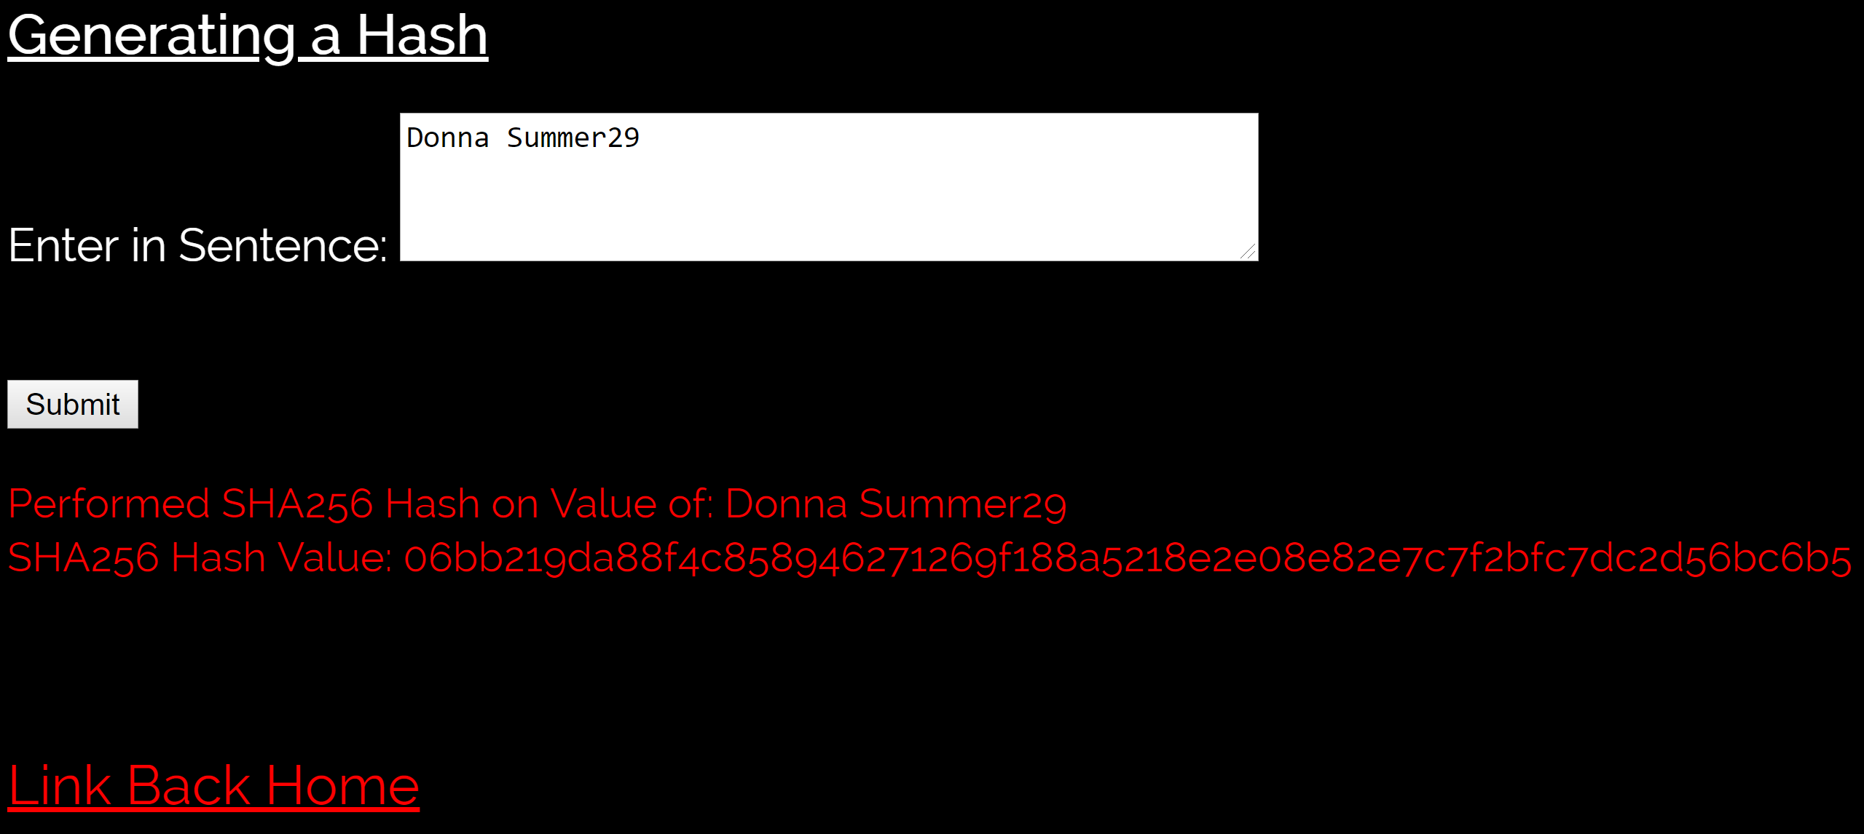
Exercise 1: Example Results

Slide 22
Exercise 2: A Hashing program that automatically searches for a nonce
The algorithm for the program is quite complex because searching for a hash and nonce value that produces the correct number of leading zeros is difficult.
This is what the miner’s role is; miners use specialized hardware to find a hash with 17 leading zeros.

Slide 23
Exercise 2: A Hashing program that automatically searches for a nonce… cont.
Steps:
Go to URL: https://tinyurl.com/ZeroHashMining2
Enter your name and the number of Bitcoins you want to give to a friend.
  * For example, Sean transfers 2 Bitcoins to Matt
Enter 5 for the number of leading zeros to generate.
Enter SHA512 for the hashing algorithm.
  What was total number of attempts?
  What was the expected number of attempts?
  How long did it take to find the nonce that generated the correct number of leading zeros?
  What was the hash rate?

Slide 24
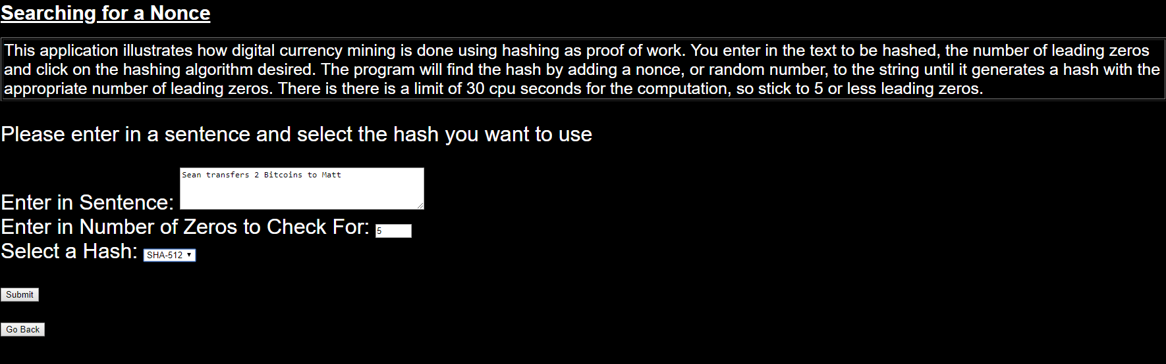
Exercise 2: Input

Slide 25
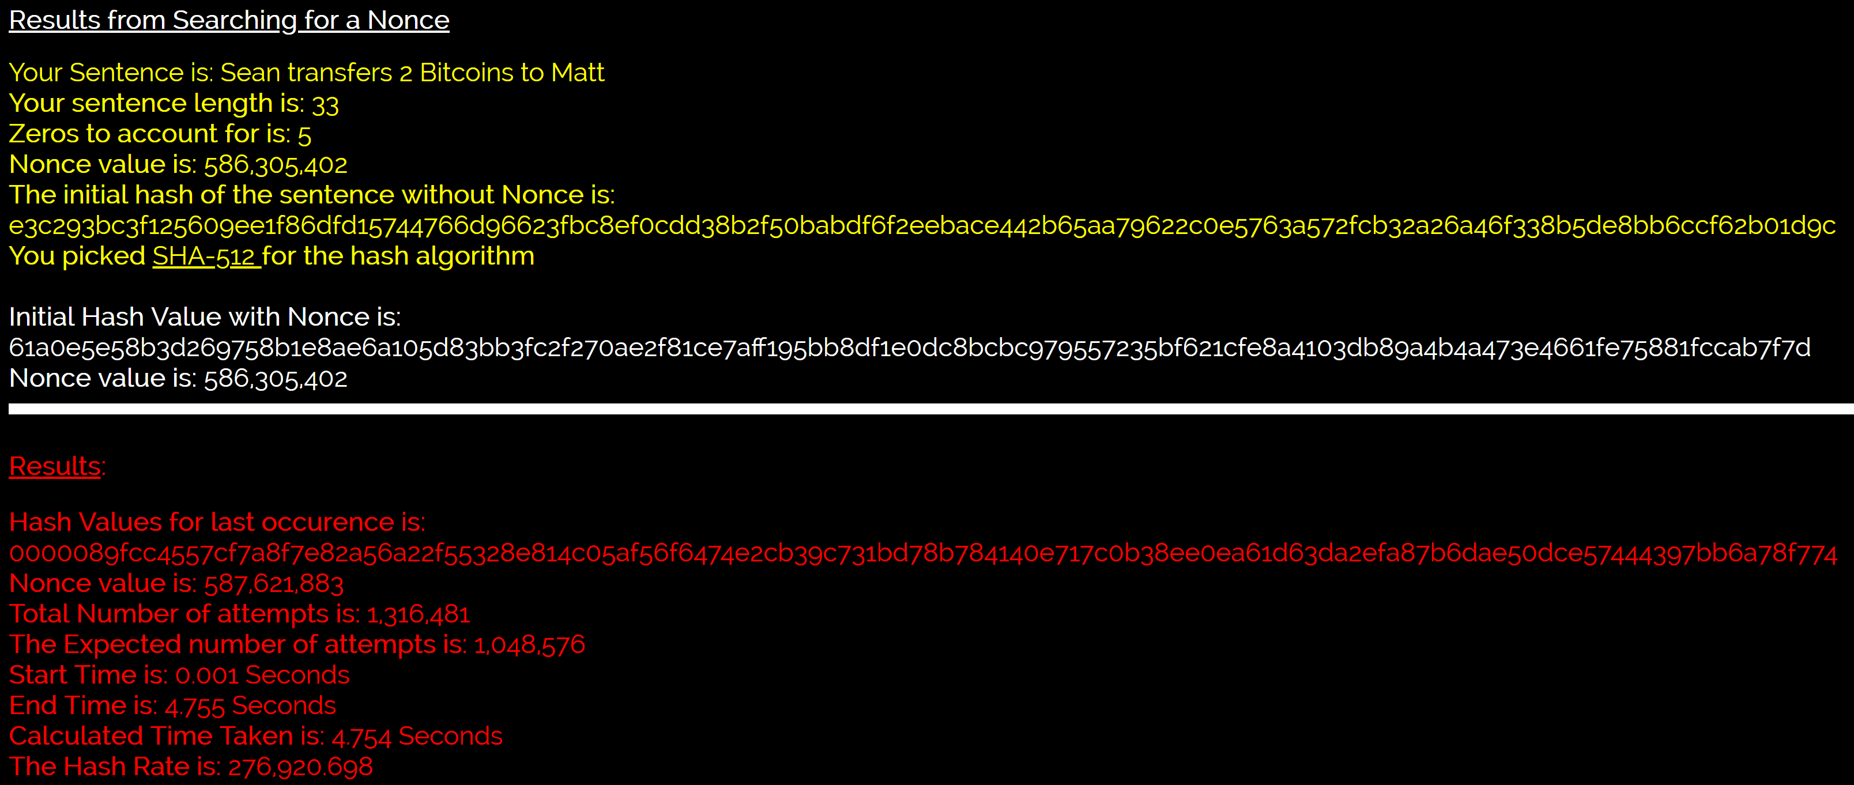
Exercise 2: Output

Slide 26
Exercise 3: Mining Computation Issues
The purpose of this exercise is to illustrate the computational demand that is required for using hashing for proof of work.
This is an advanced simulation that can be used to illustrate how the size of the text to be hashed along with the number of leading zeros influences the hash rate.

Slide 27
Exercise 3: Mining Computation Issues Continuation
Steps:
Go to URL: https://tinyurl.com/ZeroHashMining3
2. Enter your name and major
Check for four zeros
Select SHA256 for the hash
Have the simulation run for ten iterations

Slide 28
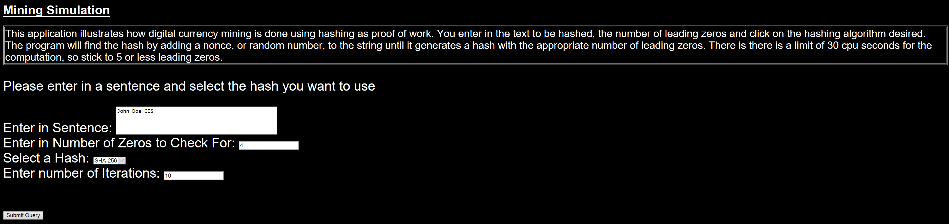
Exercise 3: Input

Slide 29
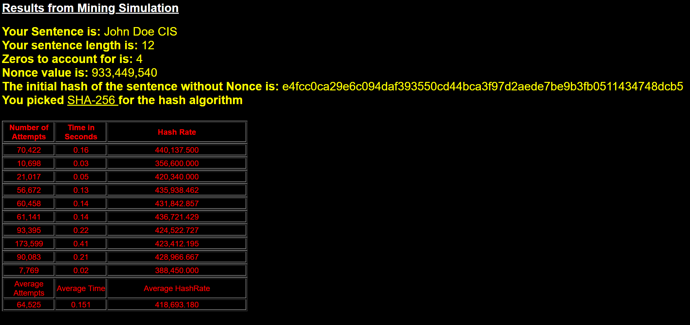
Exercise 3: Output

Slide 30
Using the above simulation
It can be used to understand how the number of leading zeros translates to computational intensity. The average number of attempts is a function of the number of leading zeros and is 16^^{n} where n is the number of leading zeros.
Students can simulate the performance of the various algorithms and copy the results into a spreadsheet. These results can then be used to write a short paper that discusses the results.
The figure on the next page was constructed by cutting and pasting the results from running the simulation 100 times for all three hash functions, by varying the number of characters from 10 through 2,000. About 76,838,804 million hashes were used to generate these results. The projected number of hashes to compute was 78,643,200.
Between 1,000 and 2,000 transaction are hashed in each Bitcoin block.

Slide 31
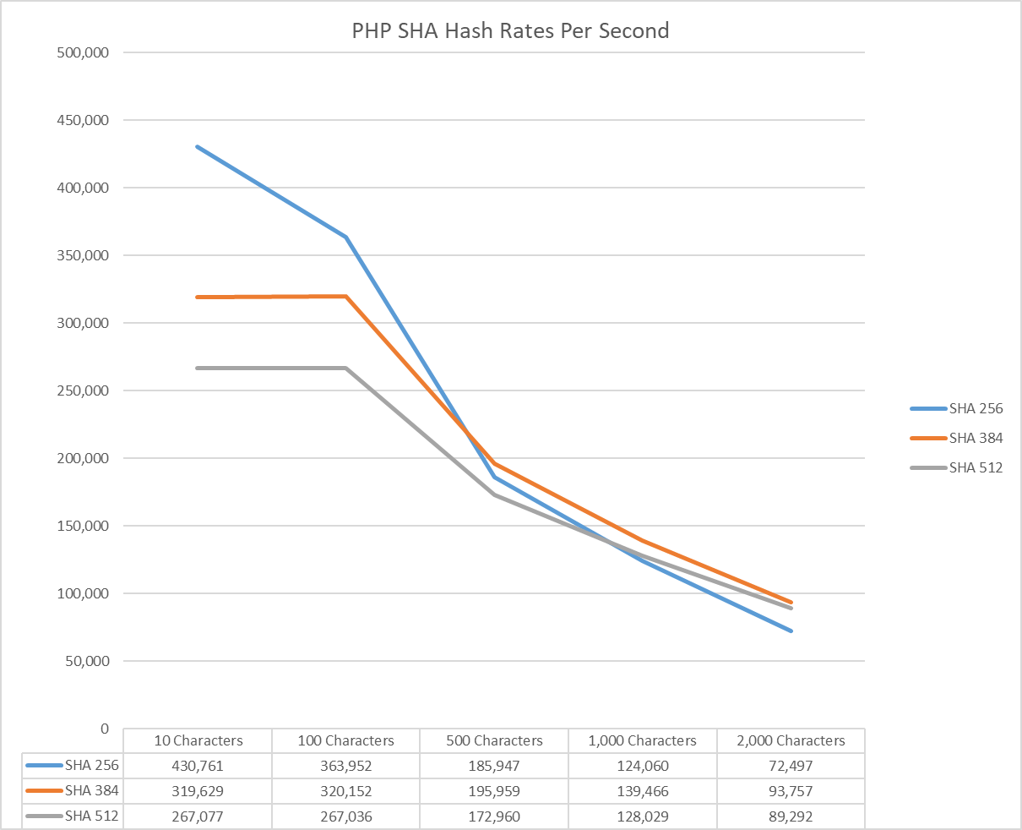

Slide 32
Exercise 3: Additional Practice
Steps:
Go to URL: https://tinyurl.com/ZeroHashMining3
Enter a 10, 100, 1000, and then 2000 character length string
Check for four zeros with all scenarios
Select SHA256, SHA384, and then SHA 512 for the hash
Have the simulation run for ten iterations
Enter the data in a spreadsheet & plot the findings.
Notes:
This is an interesting exercise addition that can help students grasp hashing and how the addition of strings does not increase the run time of the algorithms.

Slide 33
Exercise 4: Birthday Paradox and cracking secure hash algorithms
The safety of secure hash algorithms is always an issue of interest. The Birthday Paradox can be used as an approximation of the amount of brute force computing necessary to find a hash collision. The program used to illustrate the number of years to find a hash collison for various SHA bit sizes and hash rates can be found at https://tinyurl.com/BirthdyaParadoxExample.
For example, the number of years needed to find a collision for the lowly 160 bit SHA1 algorithm using 5,000 ASICS computers each capable of 13TH/s with a total hashing rate of 65,000 TH/s, is 0.74 years. This is in contrast to the 208.06 trillion years to find a collision with the SHA256 algorithm using the brute force approach.
Notes:
Note: Be sure to enter in 65000 without commas and enter in 160 bits as demonstrated in the next slide.

Slide 34
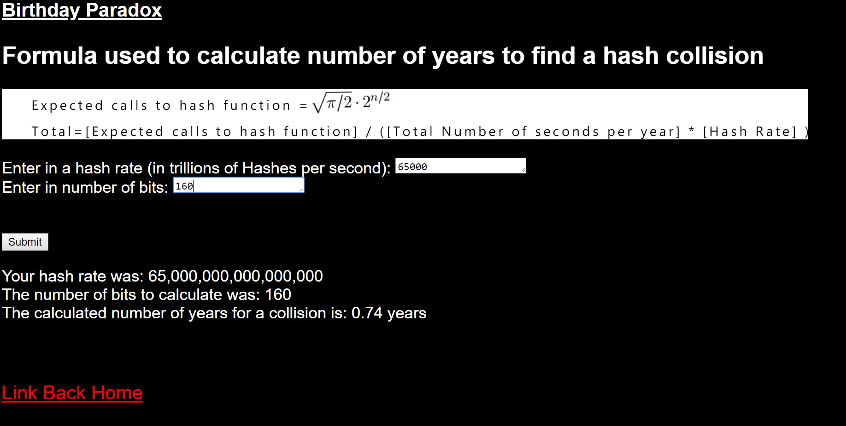
Exercise 4: Birthday Paradox and cracking secure hash algorithms input & output

Slide 35
Years to find a collision with a SHA algorithm using a hashing rate of 160 TH/S
SHA 1 (160 bits): 300.28
SHA 2 (256 bits): 84,522,589,489,233,040
SHA 3 (384 bits): 1,559,166,576,755,094,817,896,361,838,132,592,640
  The Antminer T17 executes at 40THS/s and it was priced at $831 on December 26. It would take four of them to equal 160 THS/s

Slide 36
Years to find a collision from 120 bits to 175 using 160 TH/s

Slide 37
Conclusion
Secure hash algorithms are used in a variety of settings to increase the security and integrity of data:
- To ensure that data on servers has not been changed
- For password protection
- For digital signatures and fingerprinting
- To provide proof of work in digital currency mining for blockchain mining

Slide 38
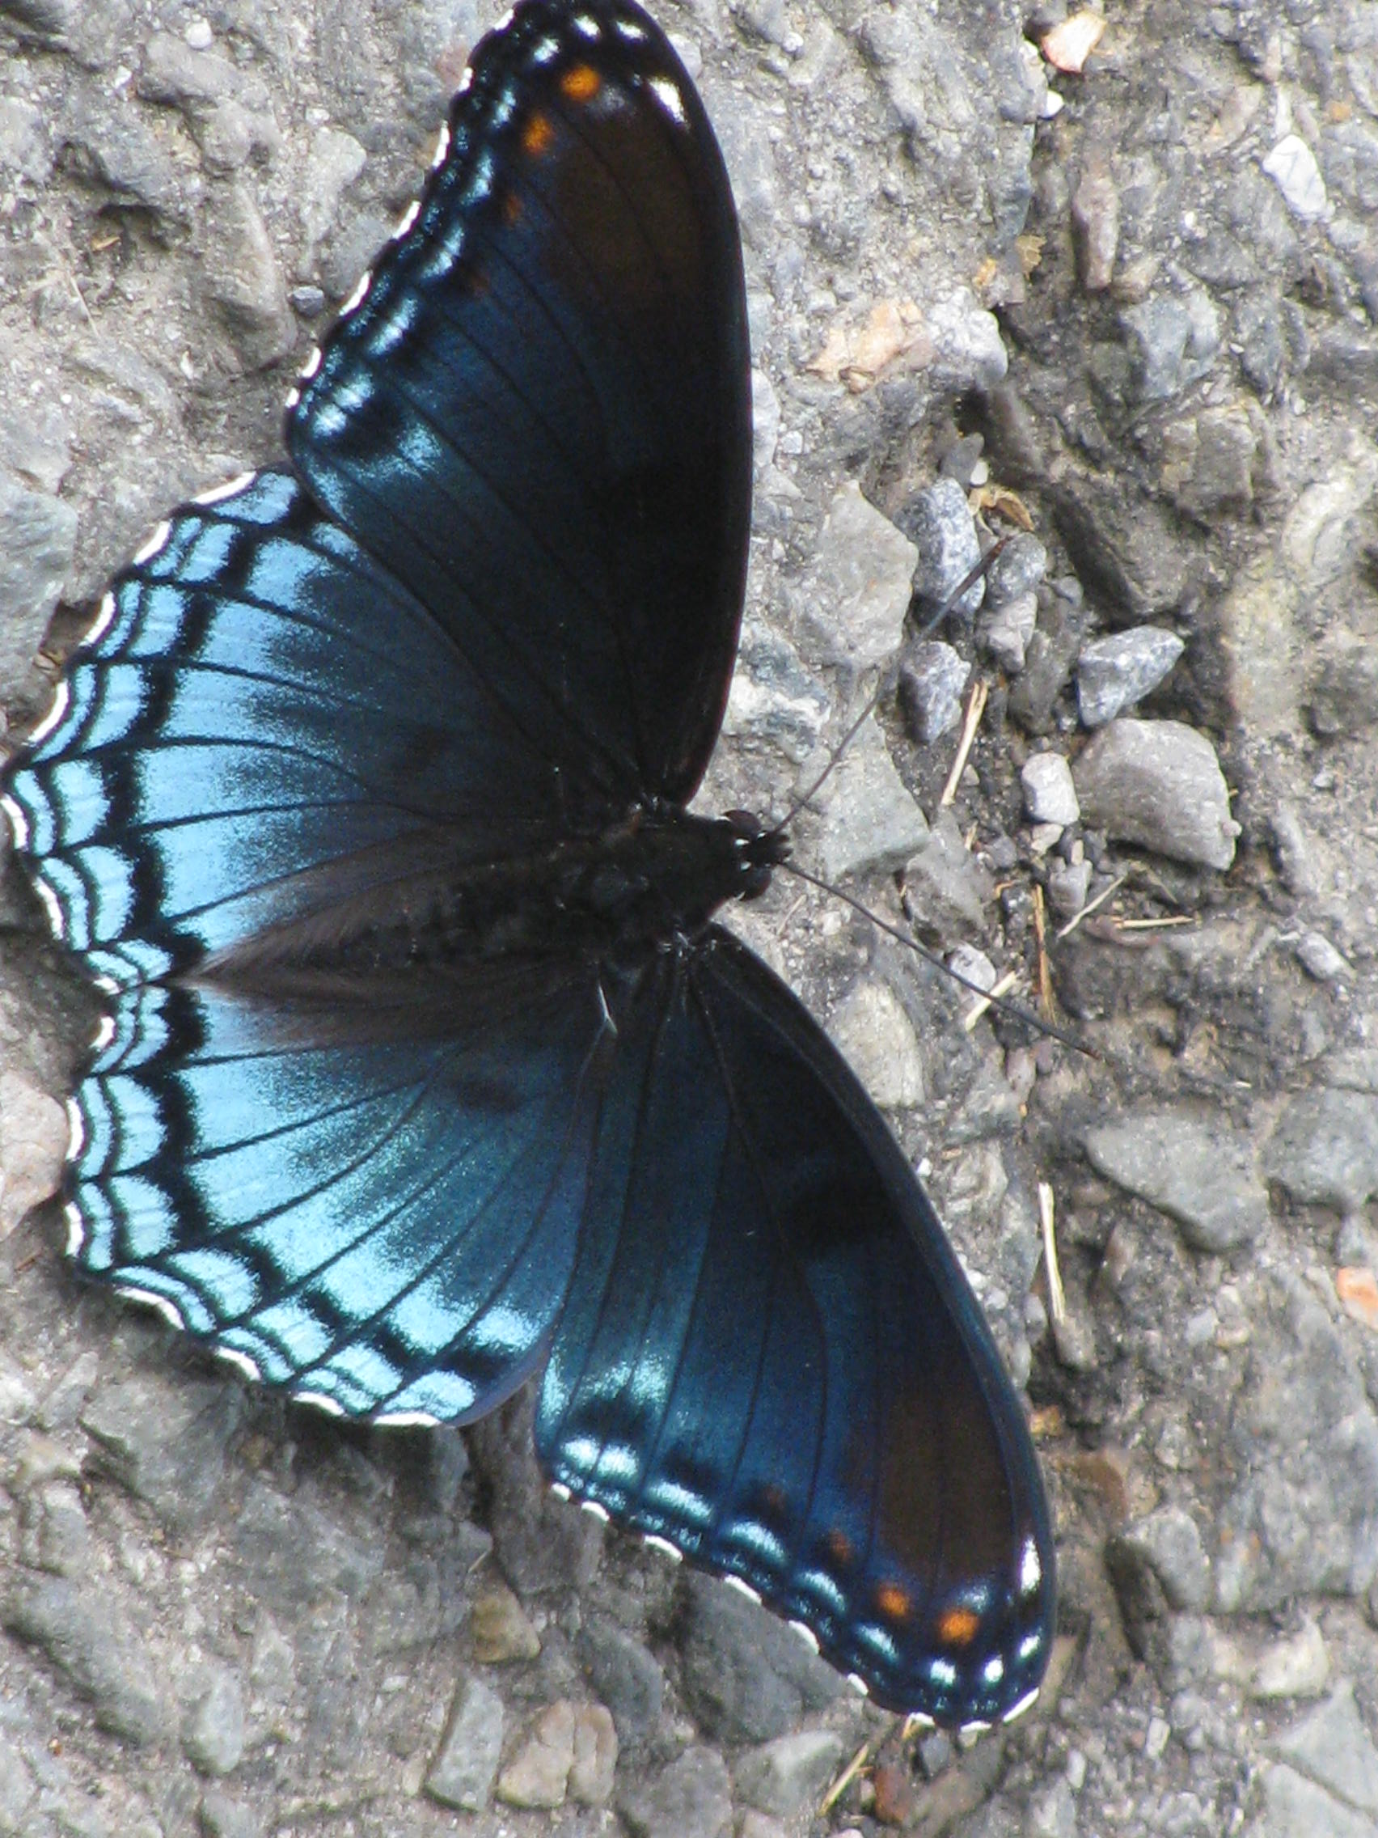
Cryptography
Cryptography
Cryptography
Cryptography
Cryptography
Cryptography
Cryptography
RSA
PKI
Bitcoin Cryptocurrency
Cryptography
Blockchain Technology

Slide 39
