Slide 1

BARTS
Smart Contract
The purpose of this presentation is to illustrate how to interact with the blockchain.

Slide 2
Topics of Discusison
Recapping BARTS
Smart Contract Programming
Android Smart Contract Programming
Summary

Slide 3
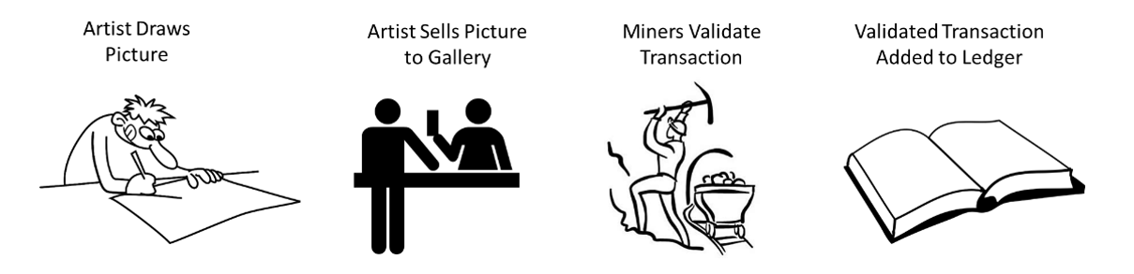
Recap: BARTS
Bitcoin-Just a cryptocurrency

Slide 4
Ethereum: Why should you care?
Flexible
Multiple networks (Private and Public)
Trading of Tokens
Still has cryptocurrency

Slide 5
What is Ethereum?
Ethereum blockchain was designed to allow for not just trading cryptocurrency, but other assets
It has revolutionized the industry and has led to many other applications

Slide 6
Implementation of Ethereum
Public Network
  Public is the live network
  Main use is for mining ether
  Also can be used for trading tokens (ERC 720 vs ERC 721)
  Example applications
    Augur
      A decentralized prediction market for forecasting real world events.
    Golem
      A global, open source, decentralized supercomputer that anyone can utilize.
    Ujo
      A music streaming platform that encompasses licensing and royalty management for artists.

Slide 7
Implementation of Ethereum Contd…
Private Network
  Used for testing
  Includes Ropsten, Kovan, Rinkeby, Goerli, and Ethereum Virtual Machine
  Private network can also be created through Geth (Ethereum Mist Wallet)

Slide 8
What is Remix and Solidity
Used for testing and development of Smart Contracts
Used to create private and public tokens such as ERC 720 and ERC 721
  ERC stands for Ethereum Request for Comment
Solidity programming language
  Similar to JavaScript syntax
  Uses many programming aspects related to Python

Slide 9
What is a Smart Contract?
A way of allowing users to interface with the blockchain
Smart contracts are essentially code that allows for users to interact with the blockchain.
Smart contracts allow for transacting between buyers and sellers

Slide 10
What are the components of a Smart Contract?
Begins with a compiler version
  pragma solidity 0.5.7;
The main contract body
Structures and other variable types

Slide 11
Variable Types
Booleans
  true/false values
  Starts with keyword bool
Integers
  Starts with int or uint
  Used to store values like 1 to infinity
Address
  Address keyword is used
  Used to store hexadecimal address

Slide 12
Variable Types Continued…
Bytes
  byte is the keyword
Arrays
  can consist of any of the previous types explained.
    EX) byte[], int[], or bool[]

Slide 13
Ethereum Remix Integrated Development Environment Interface

Slide 14
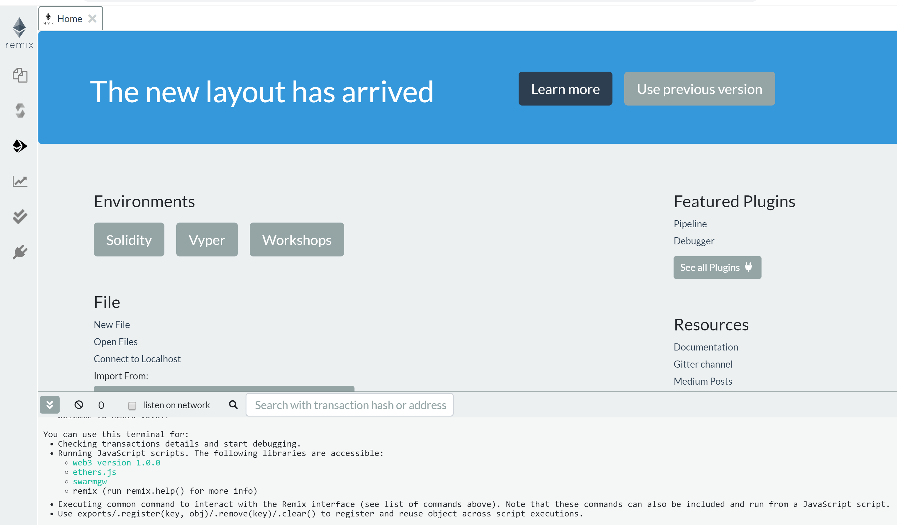
Initial View

Slide 15
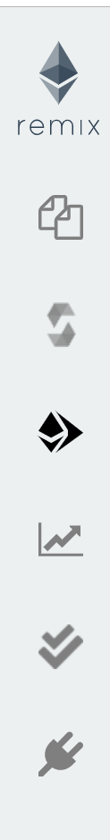
Tabs Information
Home Page
File Explorer
Solidity Compiler
Deploy and Run Transactions
Solidity Static Analysis
Solidity Unit Testing
Plugin Manager

Slide 16
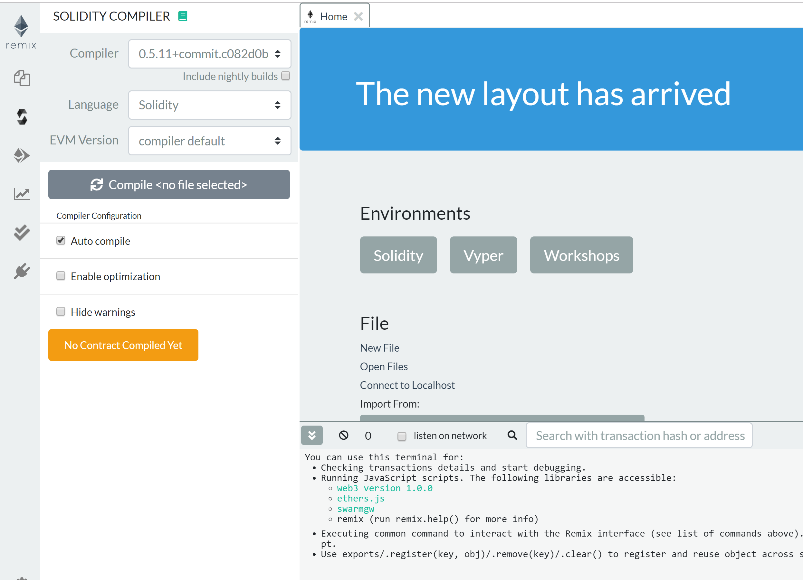
Tabs Information
Solidity Compiler
Solidity Compiler Settings

Slide 17
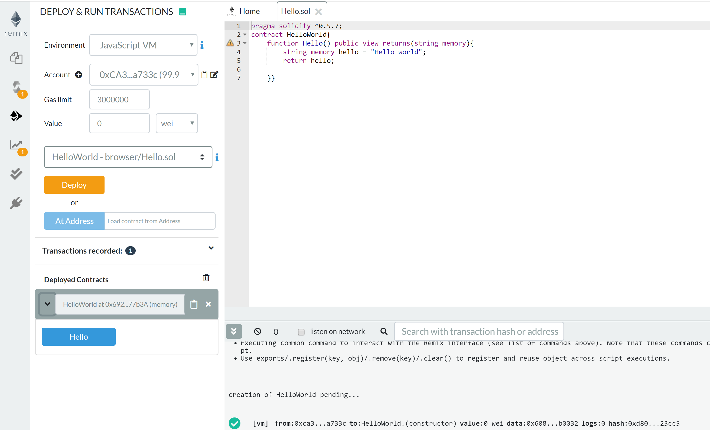
Deploy and Run Smart Contract Information
Deploy Smart Contract Section
Hello World smart contract is open.
This is the area you will be coding in.
Deployed Smart Contract Section
Smart Contract Blockchain Data Section

Slide 18
Smart Contract Example?
pragma solidity ^0.5.12;
contract HelloWorld{
function Hello() public pure returns (string memory){
return "Hello World";
}
}

Slide 19
Live Demo of Smart Contract
Want to create smart contract for hello world example and run it
Want to create a smart contract for placing bets and run it.
Lets first go to: http://remix.ethereum.org

Slide 20

Android Smart Contract Programming

Slide 21

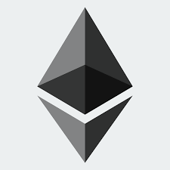
Android Smart Contract Programming
We will not be discussing everything, but more of an overview of the android programming process
Android blockchain programming is difficult because..
  Lack of tutorials on how to implement blockchain in android applications
  Requires a lot of knowledge in....
    Computer networking
    Java programming
    Blockchain smart contract programming

Slide 22

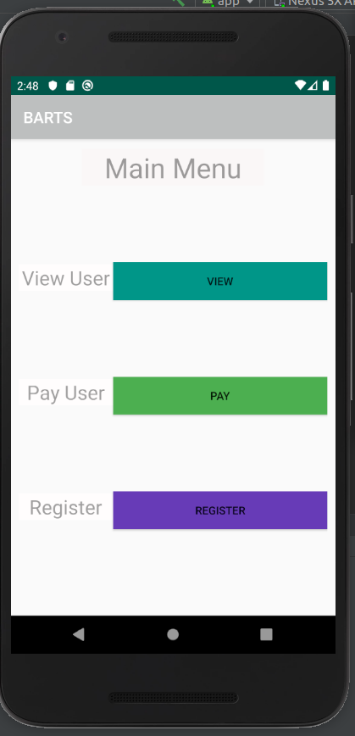
Android Programming Environment
To implement the blockchain as an Android Application I used....
  Android Studio
  Android Studio's phone emulator
  Web3j API for Android Studio through the Maven repository

Slide 23
Summary
Learned about what makes up a smart contract
Learned about what components are associated with smart contracts
Learned how to interact directly with the blockchain
Additional documentation on smart contract programming can be found at:
  Solidity Documentation (0.5.7) (Click to follow the link)
  Coursera: Bina Ramamurthy’s course (UB affiliated):
    Blockchain Basics: https://www.coursera.org/learn/blockchain-basics/home/welcome
    Smart Contract Programing: https://www.coursera.org/learn/smarter-contracts/home/welcome
    Decentralized Apps: https://www.coursera.org/learn/decentralized-apps-on-blockchain/home/welcome

Slide 24
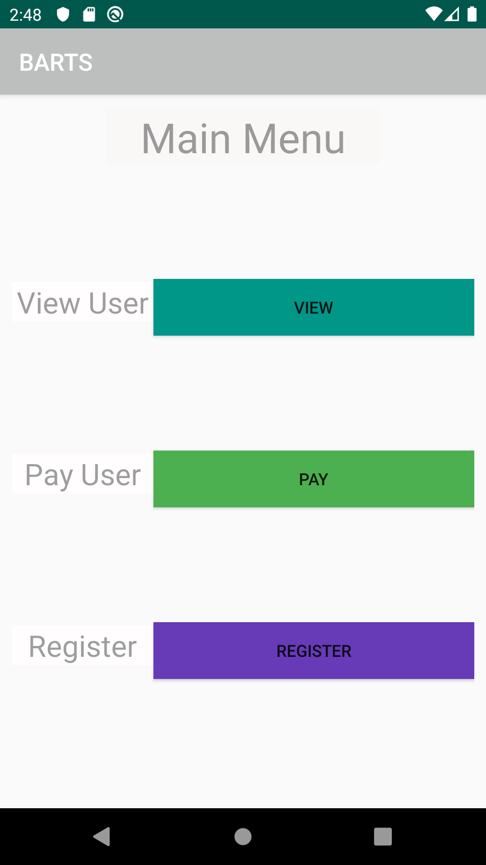
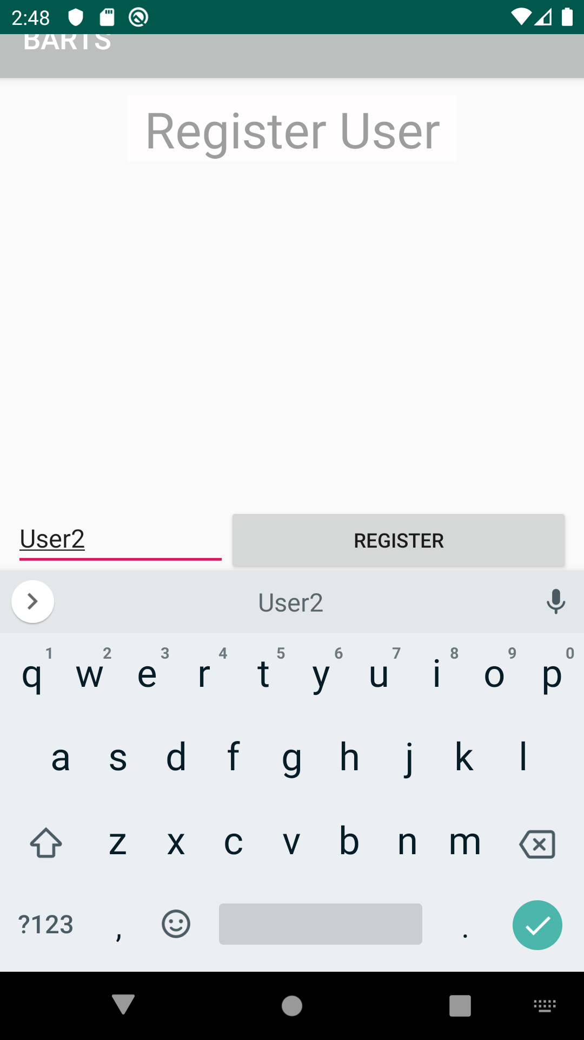
DEMO

Slide 25
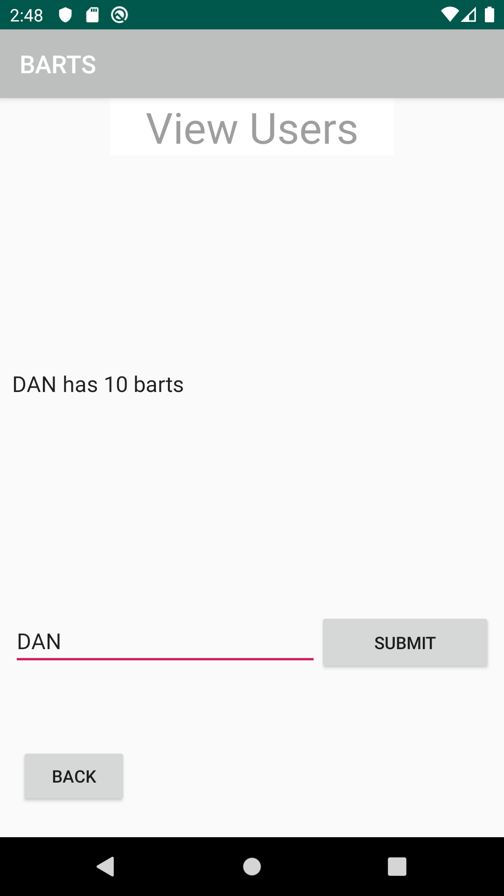
DEMO

Slide 26
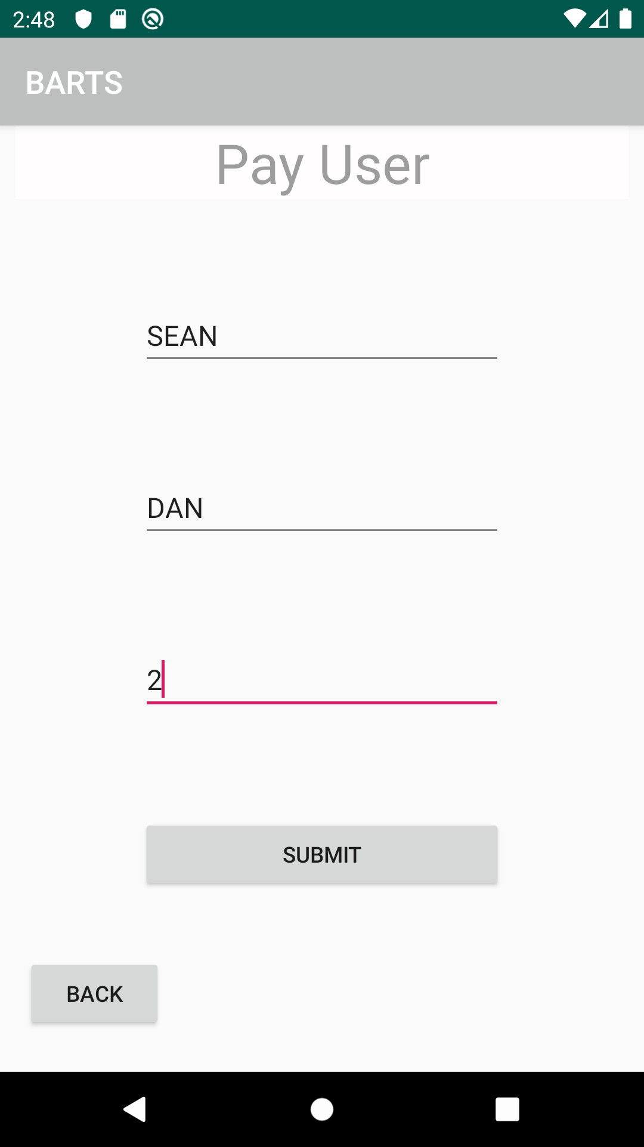
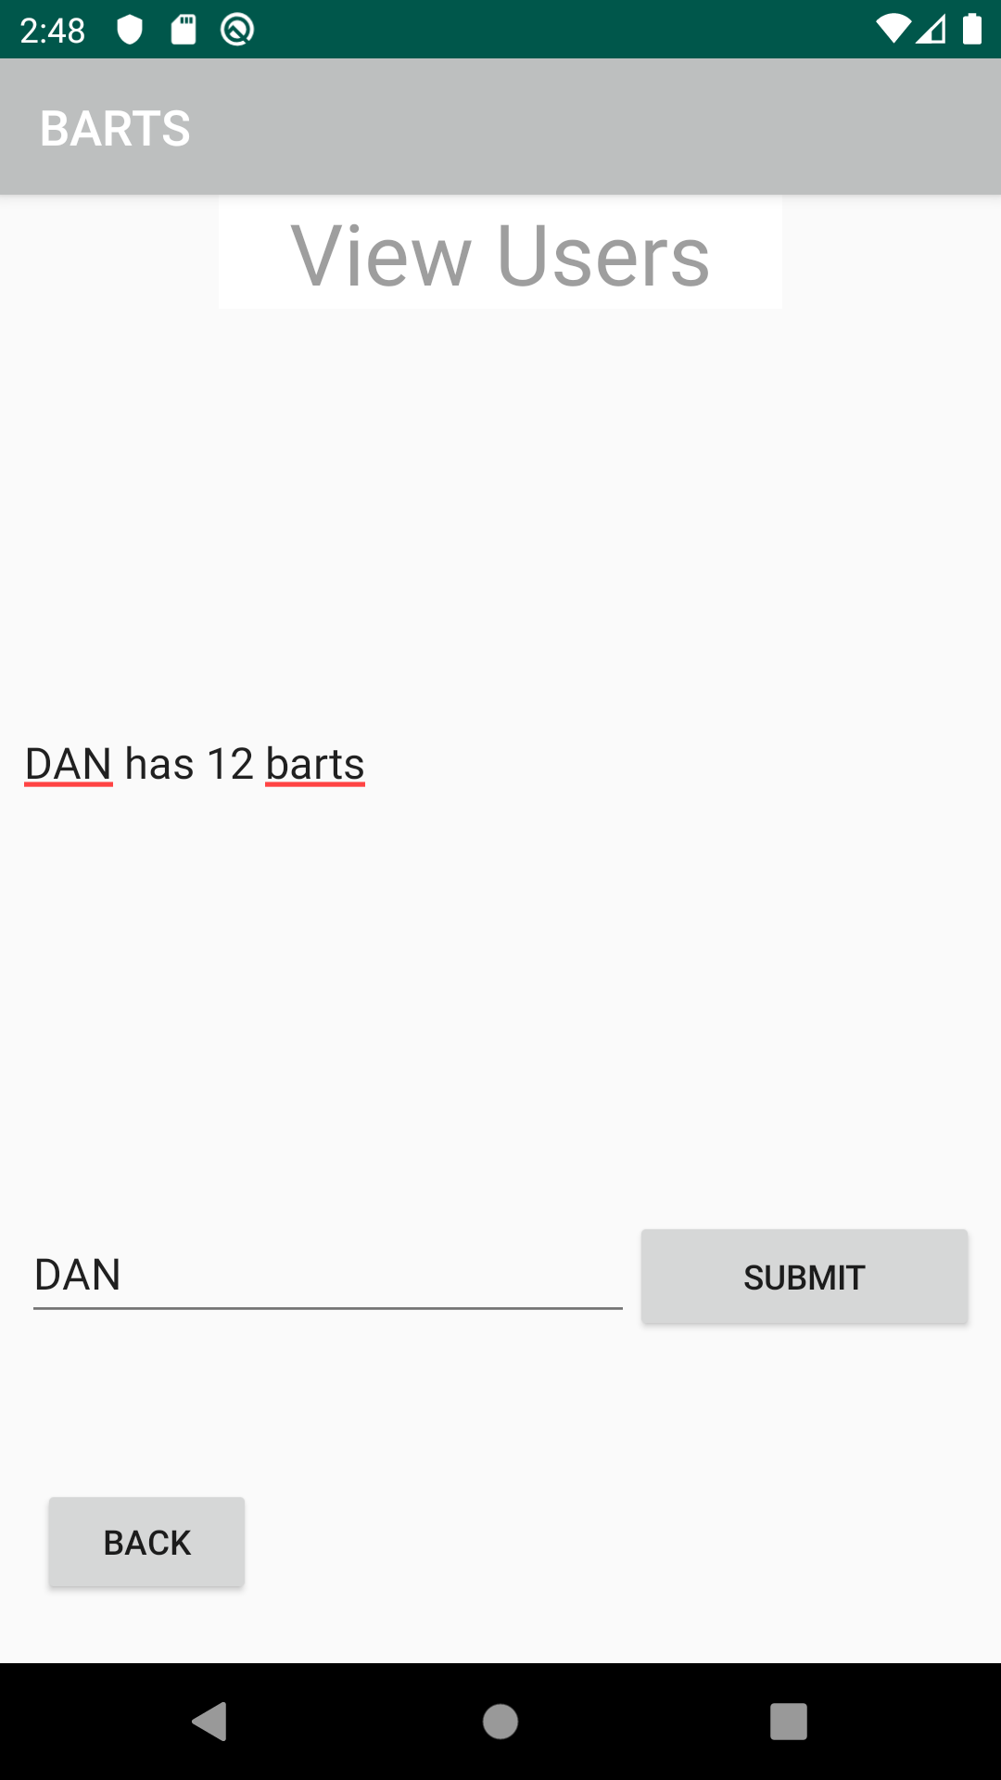
DEMO

