Slide 1



A comparison and contrast of APKTool and Soot for injecting blockchain calls into Android Applications
By: Sean Sanders and Dr. Luke Ziarek
Notes:
Welcome ladies and gentlemen.
Today I am so excited to be able to present to you "A comparison and contrast of the APKTool and Soot for injecting blockchain calls into Android Applications" by Dr. Luke Ziarek and Sean Sanders.

Slide 2
Long Term Research Goal Related to Advertising Fraud
It is estimated that the cost of advertising fraud will be $3.8 billion dollars for online retailers by the end of the year 2020.
The long term research goal is to detect advertising click fraud in Android applications using compilers and the Ethereum blockchain.
We will inject blockchain code into Android applications to help detect advertisement click fraud.
Before injecting our blockchain code the Android application has to be decompiled and then recompiled with the injected blockchain code.
Essentially, we will take existing Android applications and decompile them, inject blockchain advertising monitoring code, and then post the finite state of the ad. The finite states of the automata machine will include when the ad loads, when the ad displays, when the ad was clicked, etc.
Notes:
It is estimated that the cost of advertising fraud will be 3.8 billion dollars for online retailers by the end of the year 2020.
This paper was part of a long term research goal. The research goal is to detect advertising click fraud in Android applications using compilers and the Ethereum blockchain.
This requires that we inject blockchain code into Android applications to help detect advertisement click fraud.
Before injecting our blockchain code, the Android application must be decompiled and then recompiled with the injected blockchain code.
Essentially, we will take existing Android applications and decompile them, inject blockchain advertising monitoring code, and then post the finite state of the ad. The automata machine's finite states will include when the ad loads, when the ad displays, when the ad was clicked, and so on.

Slide 3
Where to find this material
Please visit https://www.artbarts.com/ for all of the materials discussed here
  Navigate under the section HICSS 2020
  We have included this PowerPoint presentation and some instructions related to injecting blockchain calls into Android applications
  The entire 54+ page documentation for implementing Soot and the APKTool blockchain injection into Android applications can be found under the section HICSS 2021 Blockchain Injection Documentation
Notes:
You can find the PowerPoint presentation and documentation material related to injecting blockchain calls into Android applications at artbarts.com under the section HICSS 2020.

Slide 4
Goal
The goal of the research was to demonstrate how to inject blockchain calls into Android applications using compiler tools, such as the APKTool and Soot framework.
These two compiler tools are a special advanced class of compilers that have specialized tools for instrumenting Android apps and Java code. They are more powerful than traditional compilers.
This paper sets the foundation for identifying the best compiler architecture for inserting blockchain code into Android applications to aid in the detection of mobile advertising click fraud.
Notes:
This paper's primary purpose is to demonstrate how to inject blockchain calls into an android application using compilers. Why would we want to do this? Blockchain programming is challenging, and even more so is the ability to inject blockchain calls using compiler frameworks. If you violate any of the assumptions about using the API, the application blockchain calls will not work.
So what can we do once we have a tool that can automatically inject the blockchain? We can give a user the ability to provide what they would like to store in the blockchain. More importantly, we are interested in injecting blockchain calls into Android applications to detect click fraud.
The way we accomplish this is we leverage the blockchain as a ledger to keep track of the view of the advertiser and the view of the application to make sure they coincide. As a side note we want to mention that click fraud occurs when a advertisement is lcicked on without any user interaction, but we have the ability to track other types of fraudulent behavior.

Slide 5
Research Questions
What compiler framework is best suited for injecting blockchain calls into Android applications?
Notes:
The main research question was what compiler framework is best suited for injecting blockchain calls into Android applications?

Slide 6
Contributions
We provided a description of how modern compilers can be used to inject blockchain calls into Android applications. Injecting blockchain calls into Android applications has not been done before and is a unique approach.
Notes:
In terms of the research contributions, we described how modern compilers could be used to inject blockchain calls into Android applications.
The main reason injecting blockchain calls into Android applications has not been done before is the complexity, amount of networking knowledge required, assembly x86 code knowledge, and Ethereum blockchain Android programming knowledge.

Slide 7
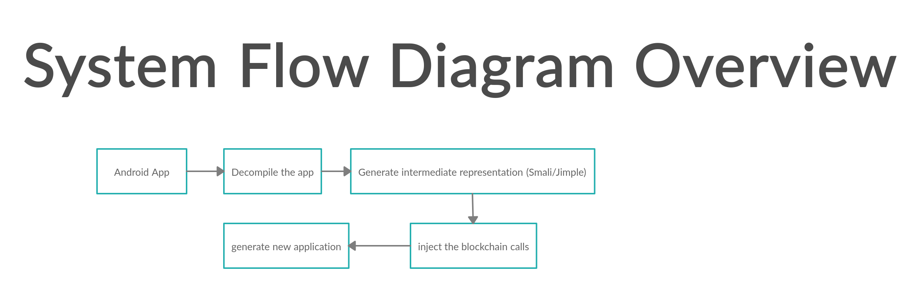
Notes:
Here I would like to go over a high-level overview of our system.
We initially have an Android application that we then decompile using either APKTool or the Soot Framework. Decompiling refers to the translation of machine language, object code, or assembly into a high-level language such as Java.
After decompiling, we generate the intermediate representation in either smali or jimple. Smali and jimple, in this case, is a low-level representation of the code. Then we inject the blockchain calls into the intermediate representation and compile them back into a new Android application. Compiling in this context means that we translate statements written in a source programming language and into machine language, object code, or assembly.

Slide 8
What compilers we used?
Soot Framework
Soot is a Java optimization framework that was developed to help optimize and inspect java code.
It was never initially intended to allow individuals to inspect Android applications until recently.
APKTool
APKTool is used to inject code and analyze Android applications.
APKTool is another tool that we used for injecting blockchain calls into the Android test application.
It appears to be easier to use than Soot at first, but it still requires a vast amount of technical knowledge (E.g. x86 assembly language) to understand where to inject calls and how the blockchain calls need to be structured.
Notes:
We opted to use Soot. Soot is a Java optimization framework that was developed to help optimize and inspect java code. Most interesting is that the Soot framework was never initially intended to allow individuals to inspect Android applications until recently.
APKTool is used to inject code and analyze Android applications.
APKTool is another tool that we used for injecting blockchain calls into the Android test application.
It appears to be easier to use than Soot at first, but it still requires a vast amount of technical knowledge (E.g., x86 assembly language) to understand where to inject calls and how the blockchain calls need to be structured.

Slide 9
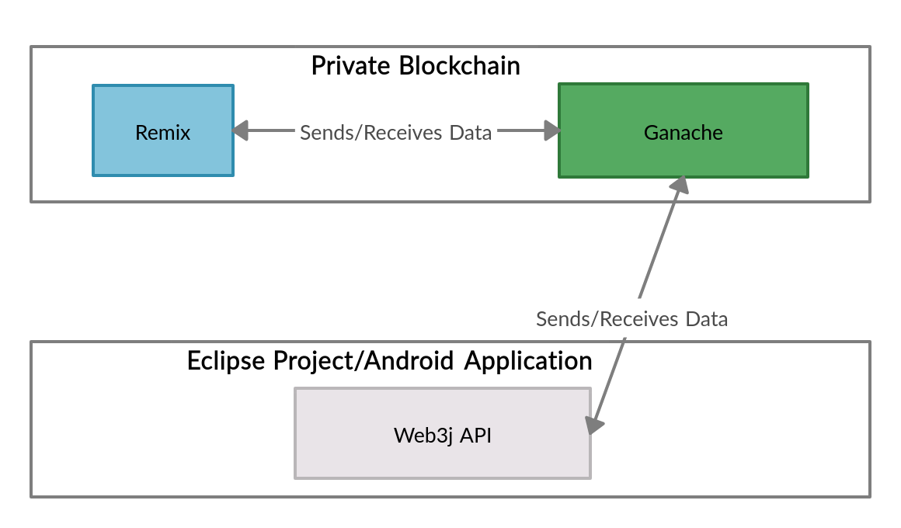
Environment Setup
Notes:
For our environment set up, we had Remix, which sent the smart contract we created to the Ganache private blockchain. In this context, Blockchain is a peer-to-peer network that allows for the sharing of data among a vast number of peers. All data stored on the blockchain is immutable.
The web3j API enabled the Android application to communicate and send data to the Ganache private blockchain's smart contract. Even though we used blockchain technology here, we could have used any other technology and the compiler framework to accomplish the task of storing the data. However, the main benefit of using the blockchain is the immutability of data.

Slide 10
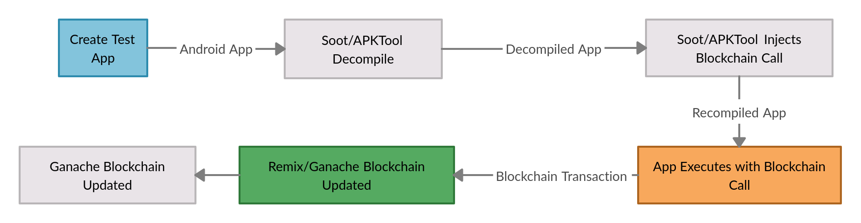
Code Injection Process
Notes:
Here is a high-level overview of the code injection process.
Initially, we create a test app in which APKTool or the Soot framework decompiles. Then the APKTool and Soot framework injects the blockchain call. When the application is executed, it runs the blockchain call, which then is sent to Ganache. Finally, the Ganache blockchain is updated once the data gets added to the blockchain block in the blockchain.

Slide 11
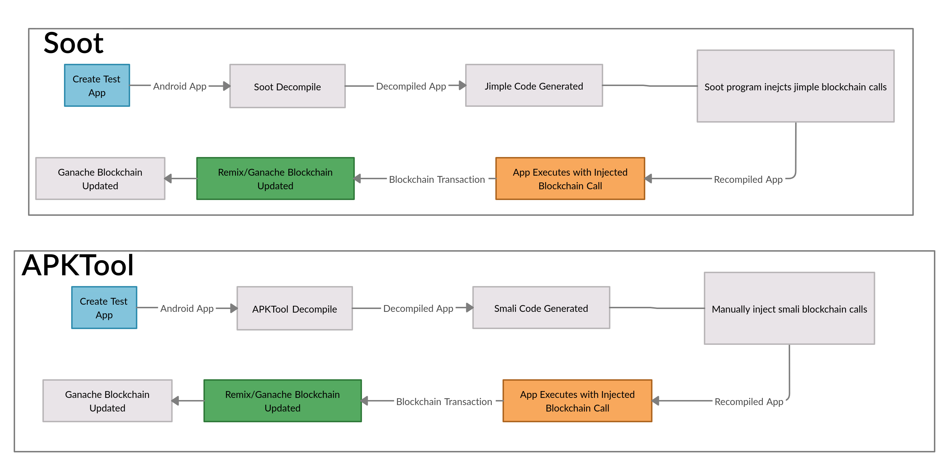
Soot vs APKTool blockchain calls inject
Notes:
Here we are demonstrating the difference between Soot and the APKTool. The main difference between the two tools is the manual versus automatic injection of the blockchain code into Android applications.

Slide 12
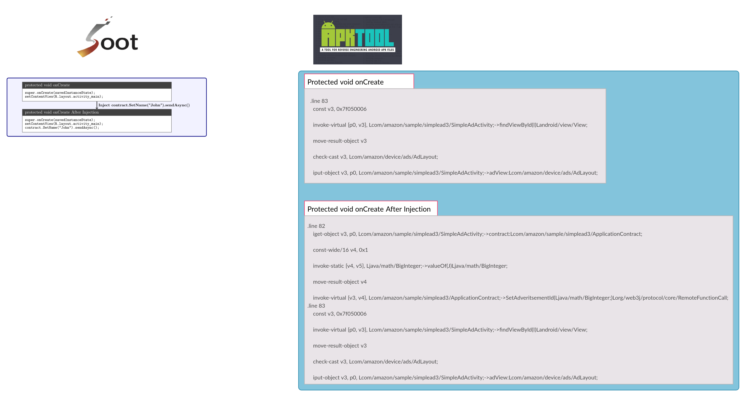
Notes:
Here I want to go over a quick example of what code injection would look like for both the Soot framework and the APKTool. I will not provide all the code because of the complexity that is involved. Essentially, I want to simplify the code a bit to make it easier to follow along and understand what we are injecting into our Android application.
Let us begin by talking about the soot framework example where we have an onCreate method with the following lines. The lines represented in the OnCreate method are responsible for setting the view for our application. What we want our compiler tool to do is inject the line contract.SetName with the input of the name "John" after the setContentView. This appears to be very easy to do using the Soot framework, but usually, in real applications, this can be quite complex. After the injection process, we will see in the onCreate method we have contract.SetName("John").sendAsync(); In jimple form, we will always have a sendAsync() after every blockchain call. The reason is that the API requires that we use an asynchronous call to send the data to the blockchain. This applies to whether we are using the private blockchain or public based blockchain.
Now let us look at the smali code representation of the same app. We will notice that we have the same onCreate method that does the same thing as what was represented under the Soot example. The main difference is there are many more lines of smali code because smali code uses registers to store the information represented as v followed by a number and then what is going into those registers. The nice thing that smali does is use line numbers to show where to inject what. For example .Line 83 is responsible for displaying the layout view. The only difference is we want to inject our blockchain call on line 82. So if we look at the section after the injection, we will see .line 82 followed by many additional registers populated with the appropriate blockchain calls and parameters.

Slide 13
Comparison of APKTool and Soot
Features | Soot | APKTool
Automated Analysis and Injection of blockchain calls | Yes | No
Language Output | Jimple, Shimple, and Baf | Smali
Can define main class for Android APK | Yes | No
Uses assembly like language | No | Yes
Can generate APK as output | Yes | Yes
Has poor documentation | No | Yes
Better suited for blockchain injection | Yes | No
Notes:
Here is a table demonstrating the differences between Soot and the APKTool.
As previously mentioned, the Soot tool can automatically inject blockchain code into Android applications, and the APKTool cannot.
More interesting is that the APKTool uses an assembly-like language syntax, unlike the Soot Framework.
Also, the documentation for the Soot Framework is much better than the documentation that the APKTool provides. This could be because the Soot Framework is much more mature and has been around longer than the APKTool.

Slide 14
Conclusion
APKTool can be useful for those familiar with assembly
Soot is a more advanced and well developed tool
Notes:
What we want people to notice after this talk is that using Soot and the APKTool to inject blockchain calls is not easy. The difficulty is that every part of the system has to work together and communicate without any errors. When instrumenting many different apps, many errors can occur. This can stem from the issue of the APK not having the right API level or the private blockchain not being set up correctly. Also, we could have errors with the injection at the compiler level where we might not have used the correct context for injecting the blockchain call.
After further analysis, we can conclude that the APKTool could be more useful for those familiar with assembly language.
We believe that the Soot framework is a more advanced and well-developed tool compared to the APKTool. This could be because the Soot framework has been around longer and is more mature than the APKTool.

Slide 15
Why we opted to use blockchain?
We wanted to utilize the blockchain technology because of the immutability of data.
  Immutability of data means that once the data is in the blockchain, it can’t be deleted or modified.
The blockchain enables the tracking and logging of transactions that take place on the blockchain.
  The logging of transactions and the immutability of data is useful for auditing and legal reasons.

Slide 16
Types of Blockchain?
Private
Not accessible to everyone in the public.
Public
Anyone can access.

Slide 17

What blockchain technology we used?
Ethereum allows developers to create and program smart contracts through the highly developed Remix graphical user interface (see: http://remix.ethereum.org/).
Smart Contracts
Ganache (https://www.trufflesuite.com/ganache)
  Used for creating private based blockchains

Slide 18
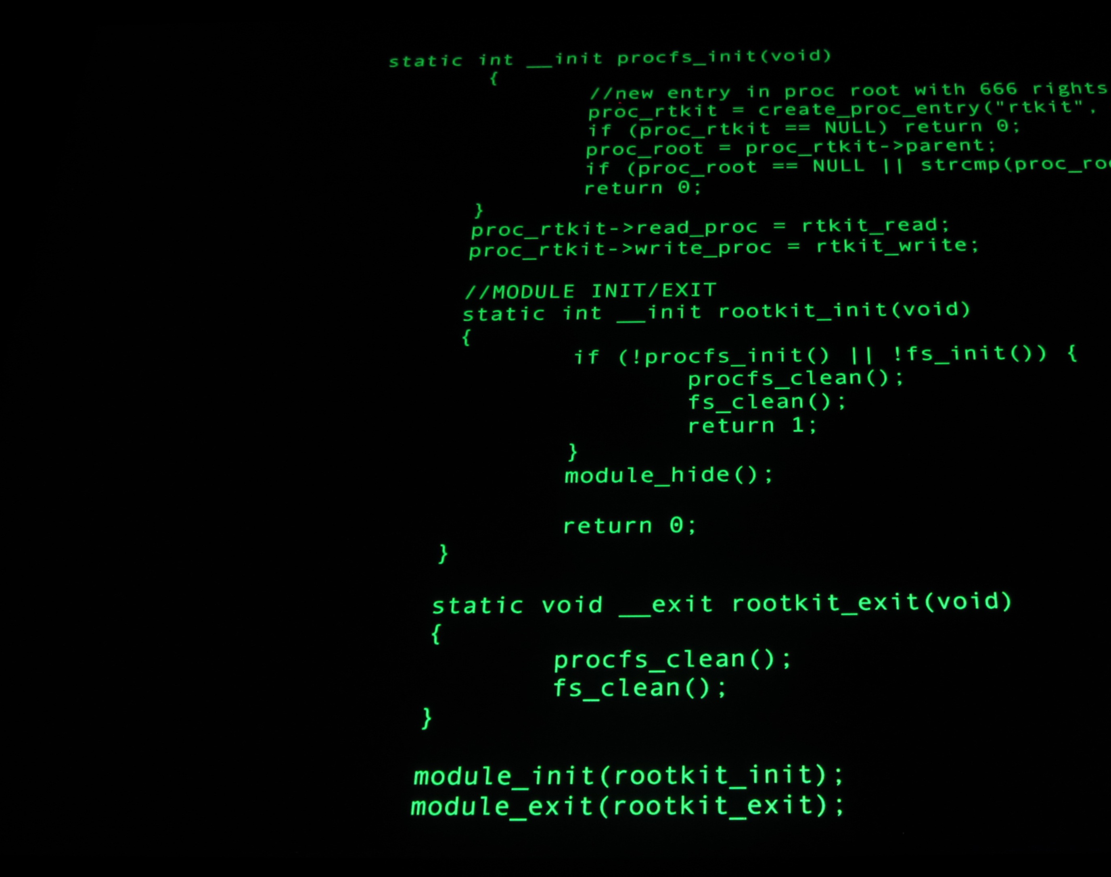
Compilers

Slide 19
What do compilers do?
Compilers are used to transform a high-level language to a low-level language.
Bytecode and machine code are examples of low-level languages.
Decompilation, takes a low-level language and transforms it to a high-level language.

Slide 20
Terminology
Compiler
  A program that translates statements written in a source programming language and into machine language, object code or assembly.
Decompiler
  A program that translates machine language, object code or assembly into a high level language such Java.
Bytecode
  A low-level representation of program code that has been compiled. It can closely resemble assembly language.
APK
  The Android Package Kit is used to distribute and for the subsequent execution of an Android application. It is similar to the exe format in Microsoft Windows.

Slide 21
Terminology continued...
Code injection
The process of injecting statements into an application at a specific location without disturbing the flow of the application code.
Soot
A compiler framework that is able to decompile and compile Java code with the capability of analysing and instrumenting Java code.
Instrumentation
Refers to the modification and analysis of a programming language through the use of compiler technology.

Slide 22
Terminology continued...
Jimple
An intermediate representation of Java code that Soot generates as output.
APKTool
A compiler framework that is able to simply decompile and compile Java code.
Smali
An intermediate representation of Java code that APKTool generates as output.

Slide 23
Terminology continued...
Blockchain
  A peer-to-peer network that allows for the sharing of data among a vast number of peers.
  All data stored on the blockchain is immutable.
Ethereum blockchain
  A blockchain environment that allows the use of smart contracts.
Smart contract
  A contract with written rules and terms allowing for controlling the storage, sharing, and modification of data.
Ganache
  A tool used for creating an Ethereum blockchain environment.

Slide 24
Terminology continued...
Solidity
  A smart contract object-oriented programming language that was developed by Ethereum.
Remix
  Ethereum’s tool that helps developers program smart contracts.
  It enables smart contract developers to connect and push smart contracts to the Ethereum blockchain.
DApps
  This refers to the decentralized, resilient, transparent, and incentivized applications that reside on blockchain infrastructures. These applications are supposedly less prone to errors.

Slide 25
Research
This paper sets the foundation for identifying the best compiler architecture for inserting blockchain code into Android applications to aid in the detection of mobile advertising click fraud.

Slide 26
Presentation Overview
Introduction
Goal of the paper
Research Questions
Contributions
Introduction to Terminology
Blockchain
Compilers
Conclusion
Long Term Research Goal Related to Advertising Fraud

Slide 27

Introduction to Soot Framework

Slide 28
Why was Soot developed?
Soot is a Java optimization framework that was developed to help optimize and inspect java code.
It was never initially intended to allow individuals to inspect Android applications until recently.

Slide 29
What we did with Soot?
We opted to inject a single smart contract call into an Android application

Slide 30
How does soot work?
The Soot framework reads in Java files, Android APK files, jimple files, and jasmin files.
  When Soot reads in these files, it examines the main class, and then builds an object that references all the main methods in the class.
  The Soot object constructs the jimple representation.
Then it looks for any code that was specified for the injection.
Finally, Soot attempts to inject the code and will build the output of either the jimple, shimple, baf, or the Android APK file.

Slide 31
How does soot work?
Java files, Android APK files, jimple files, and jasmin files
Takes as input
Soot
Outputs
Java files, Android APK files, or class files

Slide 32
Soot Output Formats
Jimple
  Simplified java code format that Soot framework uses to construct and deconstruct Android APK or Java applications.
  A typed 3-address intermediate representation.
Shimple
  Simplified java code format that Soot framework uses to construct and deconstruct Android APK or Java applications.
Baf
Dex
  Androids APK file output
Less popular are Gimp and Jasmin

Slide 33
Soot important concepts
Scene
Manages the Soot classes for the application being analyzed.
The scene holds all the Android applications classes associated with the APK that is being analyzed.
Method
Soot scenes will contain many methods.
Each method contains a body.
Locals
Every method body consist of a local.
Locals are references to the libraries that they use.
Statements
Every application method can have a series of statements.
Units
Every method can contain many units.
Consists of the statement and its assignment.

Slide 34


Introduction to APKTool

Slide 35

What is APKTool?
APKTool is used to inject and analyze Android applications.
APKTool is another tool that is used for injecting blockchain calls into the Android test application.
It appears to be easier to use than Soot at first, but it still requires a vast amount of knowledge to understand where to inject calls and how the blockchain calls need to be structured.

Slide 36
APKTool
The automation process with the APKTool is less powerful than the more developed Soot framework.
  For example, you need to manually find an entry point into the Android application.
  The main class file of the Android application is the entry point.
  More details are provided in our documentation which will be available at http://www.artbarts.com.

Slide 37
APKTool decompilation format
APKTool outputs code into Smali code.
Smali code is the human-readable format of the Dalvik byte-code and is the assembly language.
Smali code uses registers like the x86 assembly language.
Individuals that are not familiar with assembly language will have trouble understanding Smali code and how it works.
Individuals who have assembly language knowledge will be comfortable with smali code.
More importantly, you have to be able to manipulate the memory registers that the APKTool uses.

Slide 38
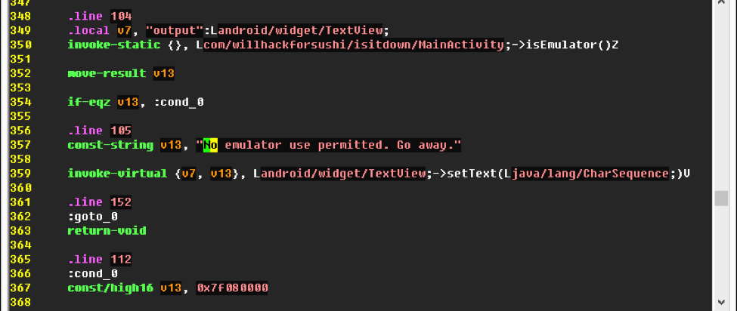
Smali code example
https://images.app.goo.gl/umM9AQcWLn75ruhL6

Slide 39
Commands
Apktool d [FILENAME.apk]
Decompile command
Apktool b [folder name]
Build command

Slide 40
Injecting Blockchain Calls into Android applications with APKTool demo

Slide 41
Conclusion
APKTool can be useful for those familiar with assembly
Soot is a more advanced and well developed tool

