Slide 1

BARTS
Smart Contract
The purpose of this presentation is to illustrate how to interact with the blockchain.

Slide 2
Topics of Discusison
Recapping BARTS
Ethereum and Implementation of Ethereum
Smart Contract and Programming
MetaMask
Summary

Slide 3
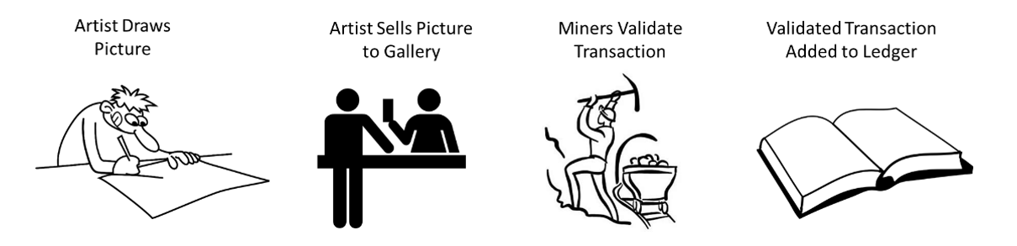
Recap: BARTS
Bitcoin-Just a cryptocurrency

Slide 4
Ethereum:Why should you care?
Flexible
Multiple networks (Private and Public)
Trading of Tokens
Still has cryptocurrency

Slide 5
What is Ethereum
Ethereum is a blockchain that was designed to allow for not just trading cryptocurrency, but other assets
It has revolutionized the industry and has led to many other applications

Slide 6
Implementation of Ethereum
Public Network
  Public is the live network
  Main use is for mining ether
  Also can be used for trading tokens (ERC 720 vs ERC 721)
  Example applications
    Augur
      A decentralized prediction market for forecasting real world events.
    Golem
      A global, open source, decentralized supercomputer that anyone can utilize.
    Ujo
      A music streaming platform that encompasses licensing and royalty management for artists.

Slide 7
Implementation of Ethereum Contd…
Private Network
  Used for testing
  Includes Ropsten, Kovan, Rinkeby, Goerli, and Ethereum Virtual Machine
  Private network can also be created through Geth (Ethereum Mist Wallet)

Slide 8
What is Remix and Solidity
Used for testing and development of Smart Contracts
Used to create private and public tokens such as ERC 720 and ERC 721
  ERC stands for Ethereum Request for Comment

Slide 9
What is a Smart Contract?
A way of allowing users to interface with the blockchain
Smart contracts allow for transacting between buyers and sellers

Slide 10
What are the components of a Smart Contract?
Begins with a compiler version
  pragma solidity 0.5.7;
The main contract body
Structures and other variable types

Slide 11
Variable Types
Booleans
  true/false values
  Starts with keyword bool
Integers
  Starts with int or uint
  Used to store values like 1 to infinity
Address
  Address keyword is used
  Used to store hexadecimal address

Slide 12
Variable Types Continued…
Bytes
  byte is the keyword
Arrays
  can consist of any of the previous types explained.
    EX) byte[], int[], or bool[]

Slide 13
Smart Contract Example?
pragma solidity ^0.5.7;
contract HelloWorld{
function Hello() public view returns{
return (“Hello World”);
}
}

Slide 14
Live Demo of Smart Contract
Want to create smart contract for tracking what is added to blockchain

Slide 15
MetaMask
Metamask is a chrome add on that is used to interact with both the public and private Ethereum networks.
It is like a cryptocurency wallet
Can be used to help aid in interacting with the test and main networks
Used to allow for connecting to Remix IDE
What if you don’t want to use MetaMask?
  Can download Ethereum Mist Wallet or other wallet that is compatible with Ethereum

Slide 16
Wallets
A crypto wallet is a program that allows you to store both private and public keys for interacting with blockchains and monitor their balances
It can be used as part of both private and public networks …
It can be used instead of Metamask

Slide 17
Summary
Learned about what makes up a smart contract
Learned about what components are associated with smart contracts
Learned how to interact directly with the blockchain
Additional documentation on smart contract programming can be found at:
Solidity Documentation (0.5.7) (Click to follow the link

